Slide 1



TCAD Process modeling simulation
SILVACO & SYNOPSYS
Build a process modeling in the Memory structure
Top 3 Memory company in the world - Micron

Slide 2
Background & Motivation
Background & Motivation
5W1H Analysis
What: Reducing cycle time in semiconductors
Why: Increasing the competition in the world
When: Development state
Who: Process integration overall in Front-end-of-line manufacturing steps
Where: 4 process flow
How: Process modeling by DoE
Combination Process Simulation Reality & Artificial Intelligence to help semiconductor manufacturing:
The correct direction
Predict running inline performance
Try a window in each step
Paper Review Guideline

Slide 3
Background & Motivation
f
Framework
Input and output files
Structure File
- Process and Electron field
Runtime Output
ATLAS
Log File
TONY PLOT
Physical structure
Structure File
Deck Build
- In Linux system

Slide 4
Background & Motivation
Inline
The purpose of a process simulator is to create a virtual representation of a physical structure.
There are four basic ways to create the structure:
1. Solid modeling (assembly of geometric shapes)
2. Photo Mask to a solid foundation
3. Process simulation using geometric style etch/deposit
4. Use a topographical etch/deposit emulation engine to simulate the etch/deposit chamber physics
Other process steps, implant diffuse, etc.,
independently have similar physics or rule-based options
We will predict :
What is an etched structure? 2. Whether doping or implementation have residue?
3. Whether each step has oxidized in each step? From Tony Plot to check 2D and 3D
→ Yield & inline (DoE with Big data)
Yield
Finally, it can allow people to predict yield performance by inline performance
Four Process Simulation & yield predication flow

Slide 5
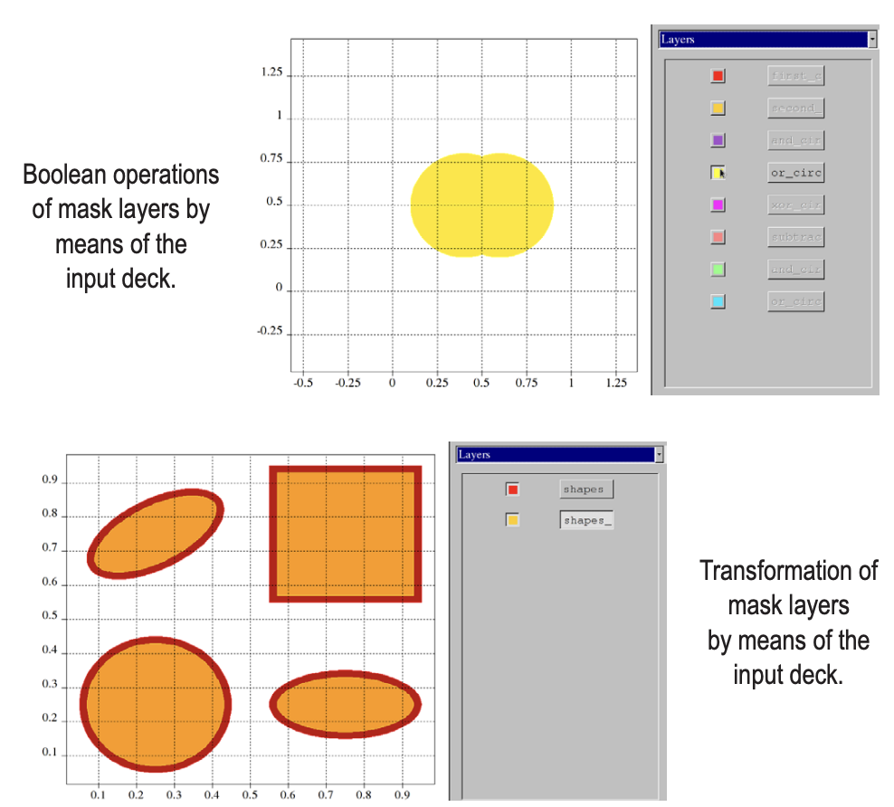
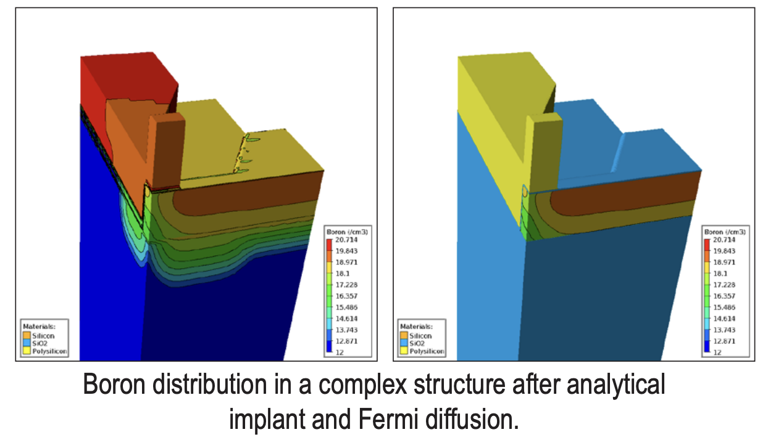
ii
Inline
Photo Mask Layout
Tony Plot check 2D, 3D and Top view
Implement Boron dose profile

Slide 6
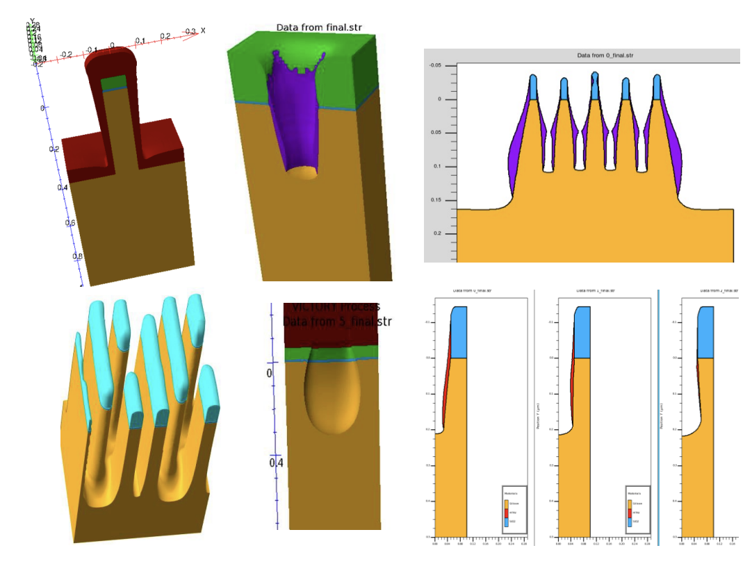
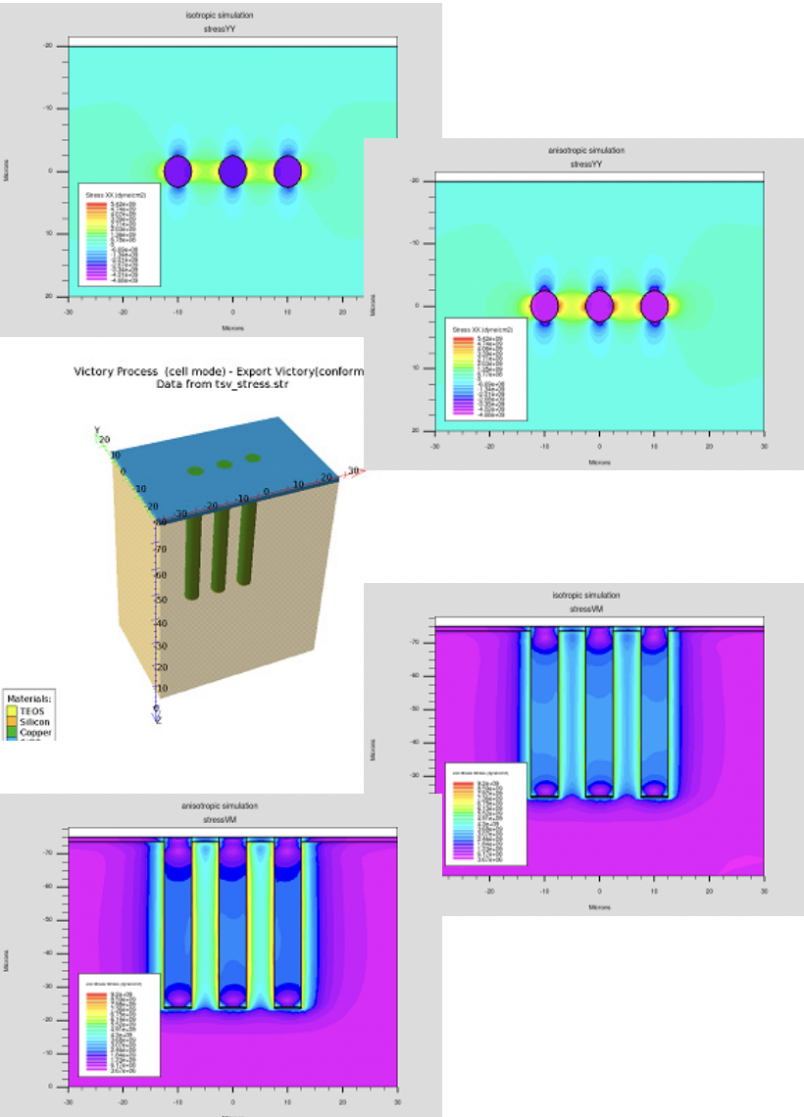

2D, 3D
Etch/deposit
Tony Plot check 2D, 3D and Top view
Inline
2D, 3D
Top view
21 process flow
40 Dep process flow
cross section
Oxidation residue
21 DE process flow
Dry etch completed
link

Slide 7
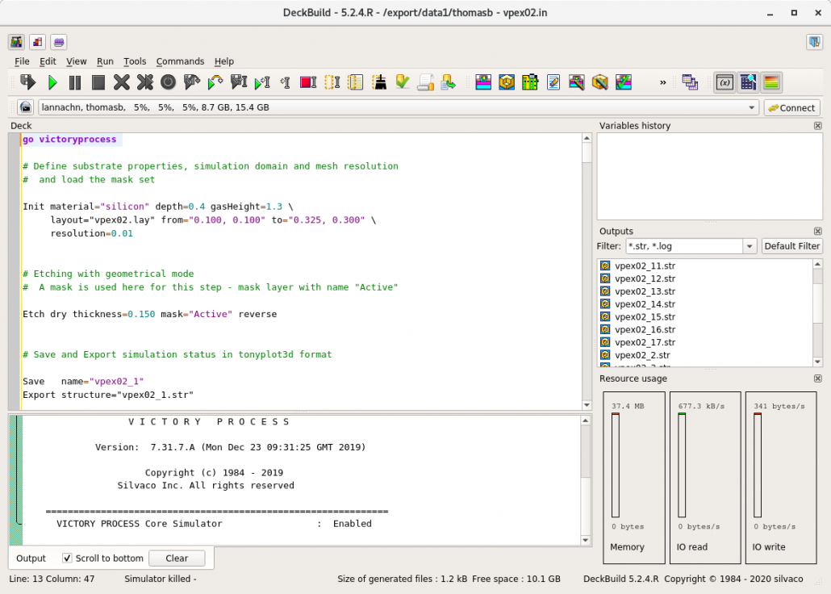
Background & Motivation
Yield & inline (DoE with Big data)
DRAM process script
Simulation of inline run DoE
Fab running performance yield and inline data
Machine learning involves using algorithms to classify collected data, including historical data and experiences
→ Find the higher accuracy
Compare DoE from Modeling with fab inline data
→ Predict yield

Slide 8
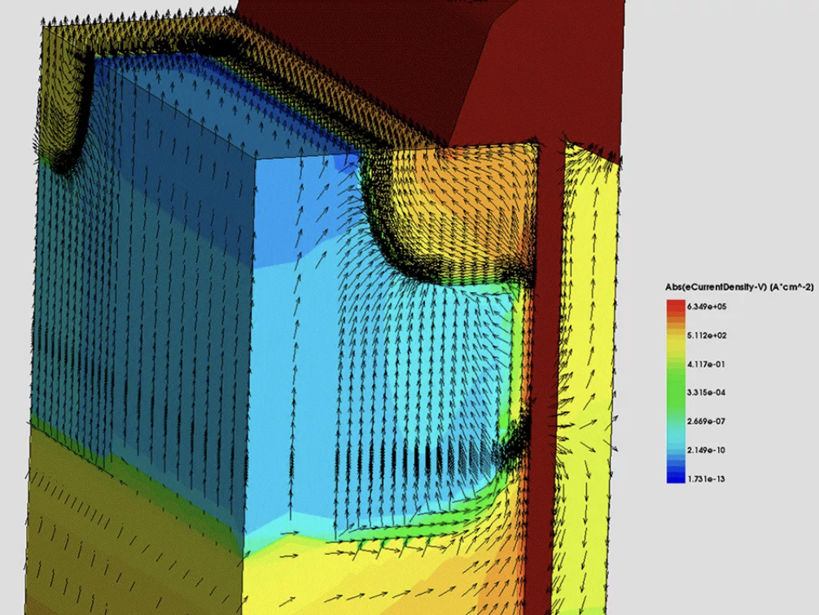
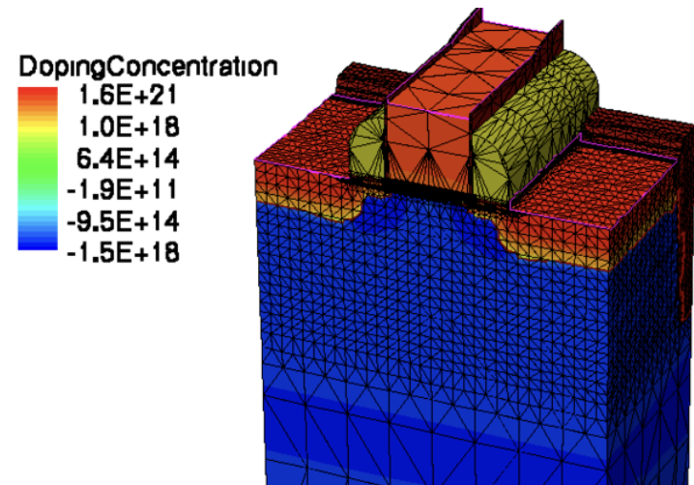
Background & Motivation
Conclusion:
Now, semiconductor fabs use Device Simulation, which stands for simulating the electrical characteristics of silicon-based and compound semiconductor devices as a response to external electrical, thermal, or optical boundary conditions [1]
Currently, TCAD Modeling of stress impact on performance and reliability [2]
Development: Process Simulation
Future Goal: Combined process simulation & device simulation
Device Simulation

